Slide 1
Functions
What is a Function?

Slide 2
Functions
Definition: A function is a mathematical rule which assigns to each input value an output value.
The set of all input values is called the domain.
The set of all output values is called the range.
Example: The following table gives the city of Holyoke’s population from 2000 to 2008
Domain $=\{2000, 2002, 2004, 2006, 2008\}$
Range $=\{39838, 40279, 40551, 40618, 40260\}$
$$Year$$ | 2000 | 2002 | 2004 | 2006 | 2008
$$Pop.$$ | 39838 | 40279 | 40551 | 40618 | 40260

Slide 3
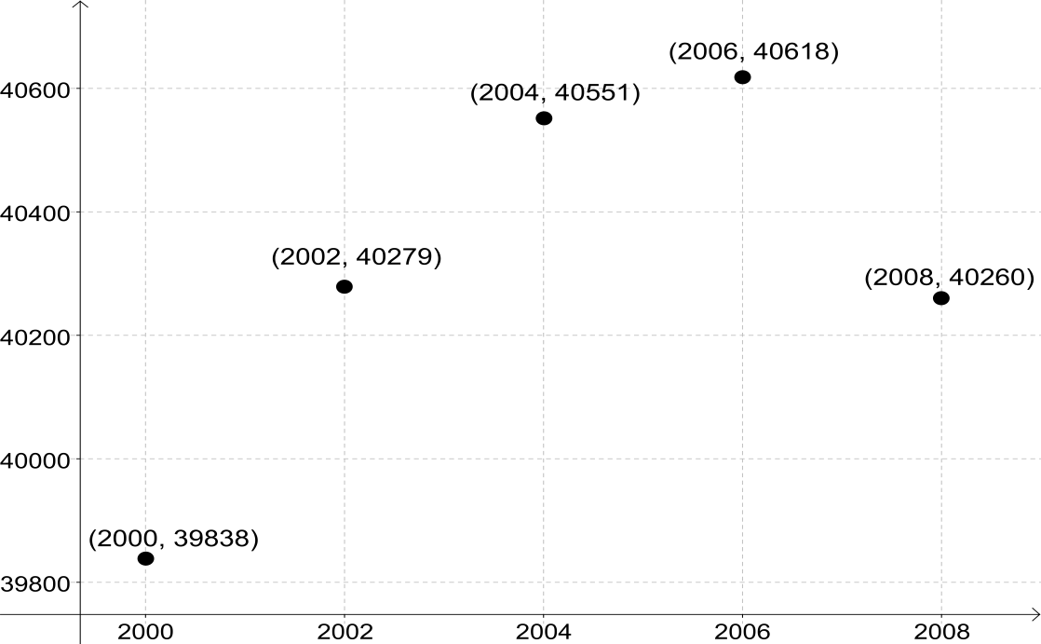
Functions
We can, also, represent this function with a graph. For each (input, output) pair we get a point on the graph.

Slide 4
Functions
Note: Tables and graphs will prove to be an extremely useful way to understand functions throughout this course. This is because applications often arise from collected data, without having an equation to guide us. Tables and graphs will act as that guide.
If we are fortunate enough to be able to find an equation for our function in an application, it is called a mathematical model.

Slide 5
Functions
Example: Suppose that gas costs $3.55 per gallon. The cost to fill our gas tank is a function of how many gallons are needed.
$$g=\# of gallons of gas purchased$$
$$C\left(g\right)=\# of dollars spent to purchase the gas$$
$$C\left(g\right)=3.55g$$

Slide 6
Functions
Example: Suppose that gas costs $3.55 per gallon. The cost to fill our gas tank is a function of how many gallons are needed.
$$g=\# of gallons of gas purchased$$
$$C\left(g\right)=\# of dollars spent to purchase the gas$$
$$C\left(g\right)=3.55g$$
The equation of the function, along with the definition of variables $g,C(g)$, make up our mathematical model.

Slide 7
Functions
Example:
$$g=\# of gallons of gas purchased$$
$$C\left(g\right)=\# of dollars spent to purchase the gas$$
$$C\left(g\right)=3.55g$$
How much does it cost to purchase 10 gallons of gas?
Solution:

Slide 8
Functions
Example:
$$g=\# of gallons of gas purchased$$
$$C\left(g\right)=\# of dollars spent to purchase the gas$$
$$C\left(g\right)=3.55g$$
How much does it cost to purchase 10 gallons of gas?
Solution: $g=10$
$C=??$
$C\left(10\right)=3.55∙10=35.50$
The cost to purchase 10 gallons of gas is $35.50.

Slide 9
Functions
Example:
$$g=\# of gallons of gas purchased$$
$$C\left(g\right)=\# of dollars spent to purchase the gas$$
$$C\left(g\right)=3.55g$$
How much does it cost to purchase 10 gallons of gas?
Solution: $g=10$
$C=??$
$C\left(10\right)=3.55∙10=35.50$
The cost to purchase 10 gallons of gas is $35.50.
$$C\left(10\right)=35.50$$

Slide 10
Functions
Example:
$$g=\# of gallons of gas purchased$$
$$C\left(g\right)=\# of dollars spent to purchase the gas$$
$$C\left(g\right)=3.55g$$
We would say that $C(g)$ is an increasing function because the amount we spend on gas increases as the amount of gas we buy increases.

Slide 11
Functions
Example:
$$g=\# of gallons of gas purchased$$
$$C\left(g\right)=\# of dollars spent to purchase the gas$$
$$C\left(g\right)=3.55g$$
We would say that $C(g)$ is an increasing function because the amount we spend on gas increases as the amount of gas we buy increases.
We would say that $C(g)$ is an increasing function because $C\left(g\right)$ increases as $g$ increases.
Definition: A function $y=f(x)$ is an increasing function if $y$ increases as $x$ increases.

Slide 12
Functions
Definition: A function $y=f(x)$ is an increasing function if $y$ increases as $x$ increases.
Definition: A function $y=f(x)$ is a decreasing function if $y$ decreases as $x$ increases.
Notice: Both of these definitions involve $x$ increasing, that is as we move to the right on the graph.

